Slide 1
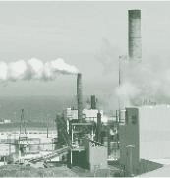
NOx
Sources and Control Methods
CE/AE 524B
Air Pollution
J. (Hans) van Leeuwen

Slide 2

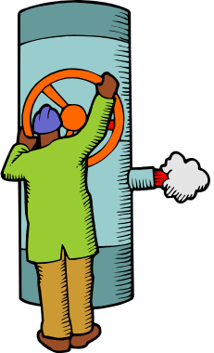
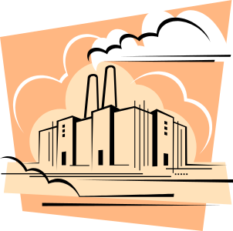
Specific sources of NO_{x}
Combustion sources
  Automobiles
  Boilers
  Incinerators
High-temperature industrial operations
  Metallurgical furnaces
  Blast furnaces
  Plasma furnaces
  Kilns
Other sources
  Nitric acid plants
  Industrial processes that use nitric acid

Slide 3
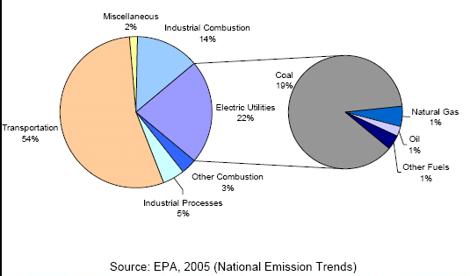
US sources of NOx

Slide 4
NOx effects (taken from EPA)
  is one of the main ingredients involved in the formation of ground-level ozone, which can trigger serious respiratory problems
  reacts to form nitrate particles, acid aerosols, as well as NO₂, which also cause respiratory problems
  contributes to formation of acid rain
  contributes to nutrient overload that deteriorates water quality
  contributes to atmospheric particles that cause visibility impairment most noticeable in national parks
  reacts to form toxic chemicals
  contributes to global warming

Slide 5
Characteristics of NOx compounds
NO – Nitric oxide
  Colorless and odorless gas
  Insoluble in water (Remember this for later on!)
  Toxic
NO₂ – Nitrogen dioxide
  Usually exists as a dimer compound (N₂O₄) at low ⁰C
  Has distinct reddish-brown color
  Moderately soluble in aqueous liquids
  Toxic
  Contributes to brown haze that occurs with smog

Slide 6
NOx Regulation
NOx concentrations are relatively low in the atmosphere, so why are they regulated?
A. NO and NO₂ react rapidly with other compounds, creating ozone and other undesirable compounds. The NO and NO₂ may never reach high concentrations, but are creating other air pollutants.

Slide 7
NOx Formation
Formed at elevated temperatures during combustion of fuel in the presence of air.
Approximately 90 to 95% of the nitrogen oxides generated in combustion processes are in the form of nitric oxide (NO). (Remember this for later on!)
Once in the atmosphere, the NO reacts in a variety of photochemical and thermal reactions to form NO₂.

Slide 8
NOx Formation
Thermal NOx: formed by reaction between N₂ and O₂ in the air; sensitive to temperature
Fuel (or Prompt) NOx: formed from combustion of fuel containing organic nitrogen; dependent on local combustion conditions and nitrogen content in the fuel.
Not all of the fuel nitrogen compounds are released during combustion. Unlike sulfur, a significant fraction of the fuel nitrogen remains in the bottom ash or in the fly ash.

Slide 9
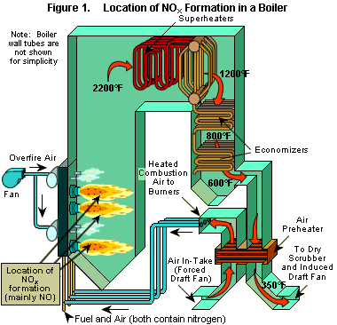

Slide 10
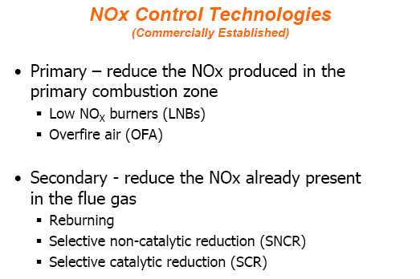
NOx control technologies
See also:
http://www.netl.doe.gov/technologies/coalpower/ewr/nox/control.html

Slide 11
Control Techniques
1. Modify combustion to suppress NOx formation
  Low excess air operation
  Off-stoichiometric combustion
  Flue gas recirculation
  Natural gas reburning
Reduce Nox to molecular nitrogen through controls (also known as flue gas treatment)
  Selective Non-Catalytic Reduction (SNCR)
  Selective Catalytic Reduction (SCR)
  Dry Sorption

Slide 12
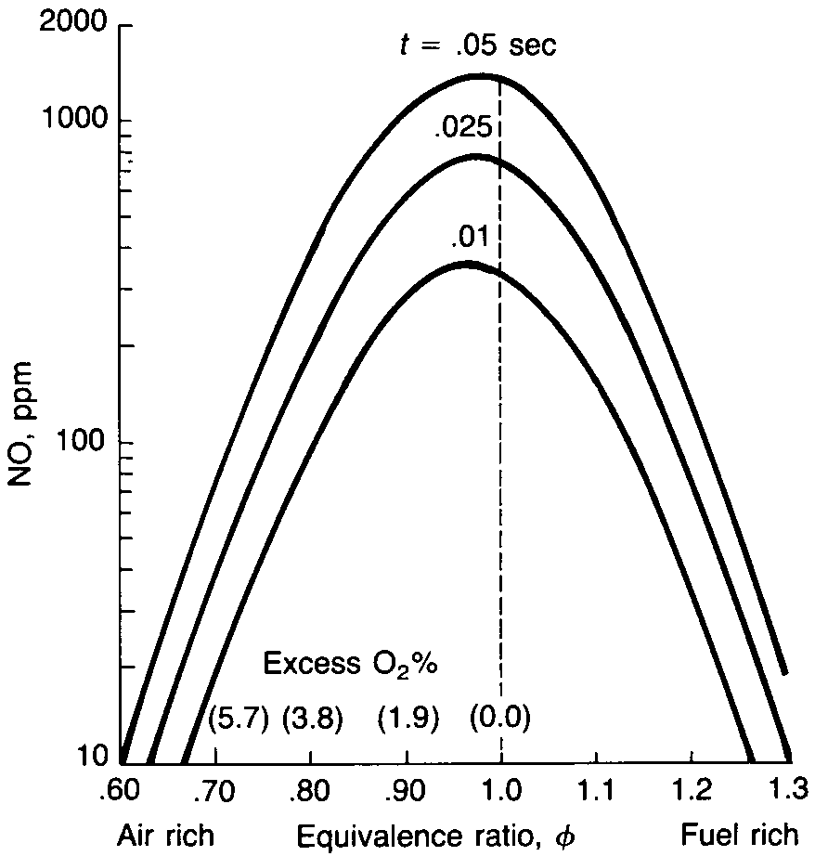
Strategies for Combustion Modification
Reduce peak temperatures of the flame zone
Reduce gas residence time in the flame zone

Slide 13
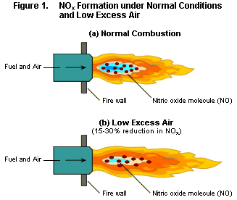
Combustion Modifications
Low excess air operation: Involves a reduction in the total quantity of air used in the combustion process. By using less oxygen, the amount of NOx produced is not as great.

Slide 14
Combustion Modifications
Off-stoichiometric combustion: Involves the mixing of the fuel and air in a way that reduces the peak
gas temperatures and peak oxygen concentrations.
Low NOx burners: Keeps temperatures down and dissipates heat quickly
Overfire air (OFA): Keeps mixture fuel rich and completes combustion process using air injection nozzles
Burners out of service (BOOS): Operates alternate burners in combustion zone as fuel rich, air rich, and air only

Slide 15
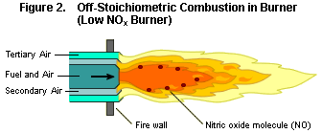

Slide 16
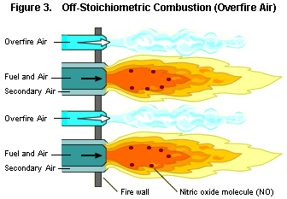

Slide 17
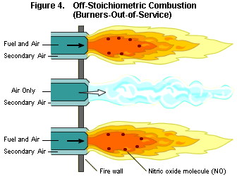

Slide 18
Combustion Modifications
Flue gas recirculation
Involves the return of cooled combustion gases to the burner area of the boiler. Reduced temperatures produce less NOx. The process requires a recirculation fan and duct system.

Slide 19
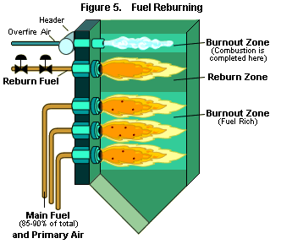
Combustion Modifications
Fuel reburning: Involves the operation of the main burners in a boiler at very low excess air (fuel rich conditions). A series of overfire air ports are used in this upper region to provide all of the air needed for complete combustion.

Slide 20
Add-On Controls (Flue Gas Treatment )
Selective non-catalytic reduction systems (SNCR)
Involves the injection of ammonia (NH₃) or urea into the hot gas zone where reactions leading to reduction of nitrogen oxides can occur. The reactions are completed within the boiler, and no waste products are generated. There is a risk of ammonia (NH₃) being emitted into the atmosphere if temperatures are too low, however. SCNR systems are capable of reducing nitrogen oxides from 20 to 60%.

Slide 21
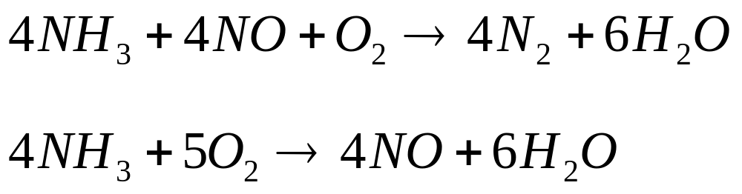
Add-On Controls (Flue Gas Treatment )
Selective Noncatalytic Reduction (SNCR) Reactions:
Above 1000 ºC

Slide 22
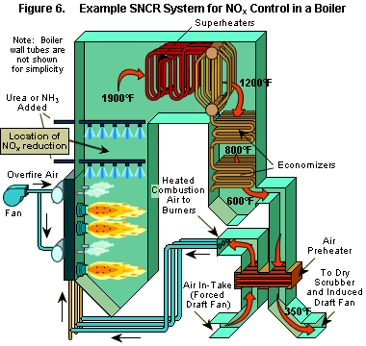

Slide 23
Add-On Controls (Flue Gas Treatment )
Selective catalytic reduction (SCR)
Involves using beds containing ammonia or urea to reduce nitrogen oxides to molecular nitrogen and water. Two or three catalysts (usually tungsten and vanadium) are arranged in honeycomb shapes in the beds so air can flow through. NOx reduction efficiencies ranging from 75 to 90% are possible when the amount of catalyst is sufficient, the catalyst is in good condition, the ammonia reagent flow is sufficient, and the ammonia is adequately distributed across the gas stream.

Slide 24
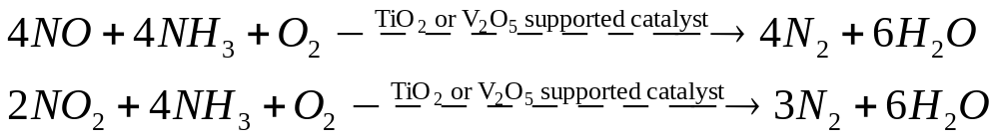
Add-On Controls (Flue Gas Treatment )
Selective Catalytic Reduction (SCR) Reactions
Temperature ~ 300 - 400 ºC

Slide 25
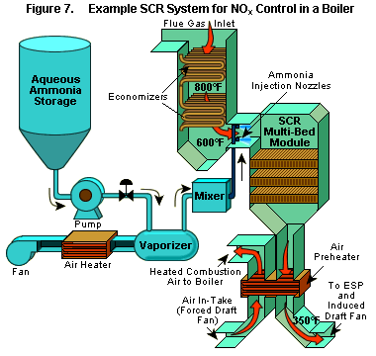

Slide 26
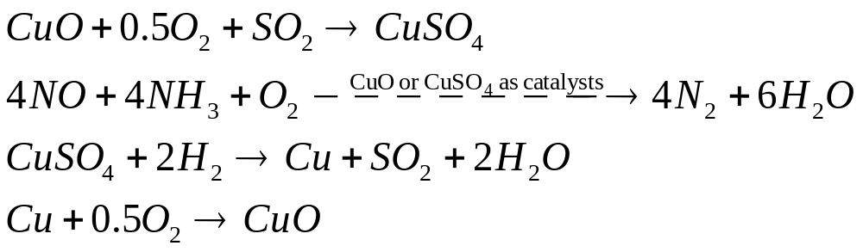
Add-On Controls (Flue Gas Treatment )
Dry Sorption
  Activated carbon (220 ~ 230 ºC)
  Shell Flue Gas Treating System (~ 400 ºC)
  Alkali Metal and Alkali Earth Metal based sorbents

Slide 27
Final Remark
  Would wet scrubbers be a good control technique for NO_{x} emissions?

Slide 28
Final Remark
Wet scrubbers would not be a good control technique for NO_{x} emissions.
Why? Remember, NO is mainly formed during the combustion process and NO₂ is formed in the atmosphere. Since NO is insoluble in water, wet scrubbing would not work very well!

